Slide 1
Visual CAFE Rewrite
Overview and Proposed Architecture

Slide 2
Primary Problem

Slide 3
Other Considerations

Slide 4
Approach
Rewrite UI
Leave Backend Alone for Now
Prioritize speed over new features

Slide 5
Technologies

Slide 6
Required Libraries
FREE

Slide 7
UI Libraries (optional)
Most are
FREE
Dozens of others

Slide 8
Other Libraries
Depending on scope, several other smaller libraries will be utilized. Most or all should be open source and free to use.

Slide 9
Architecture
Single Page App (SPA)

Slide 10
Architecture
Responsive Design

Slide 11
Mobile

Slide 12
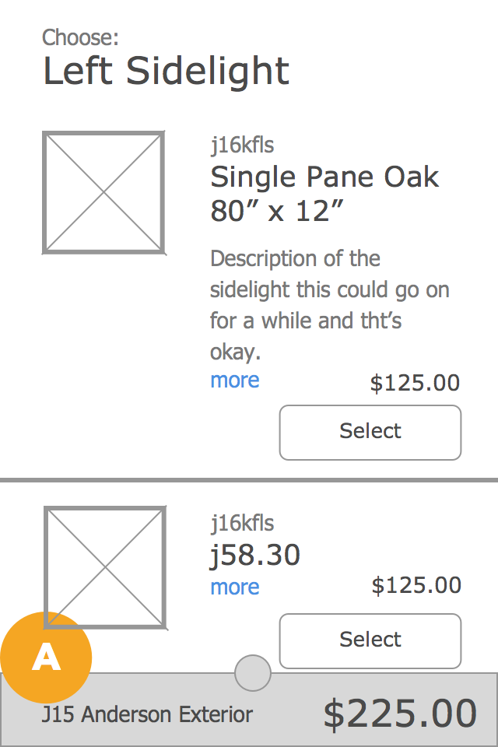

Slide 13
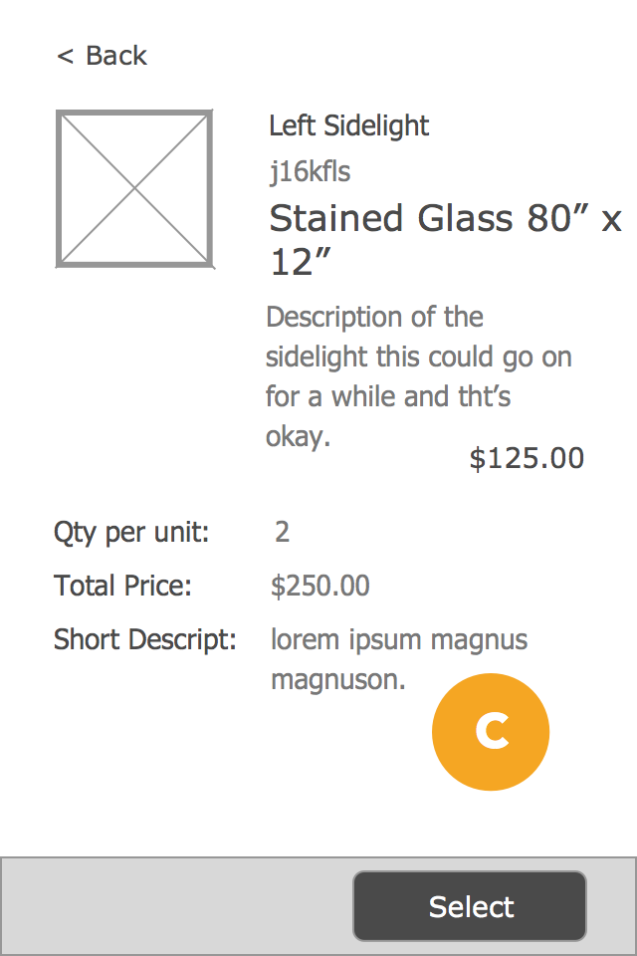

Slide 14
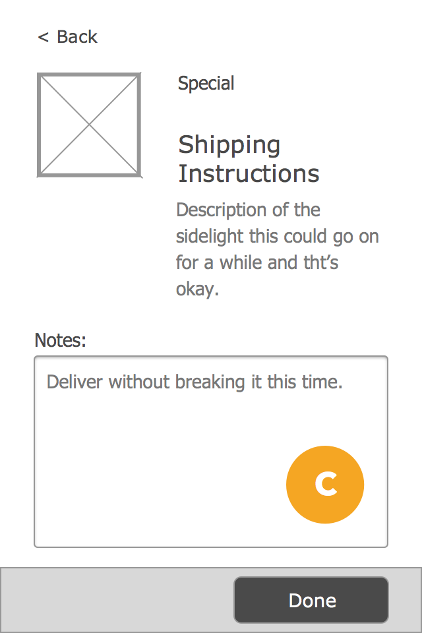

Slide 15
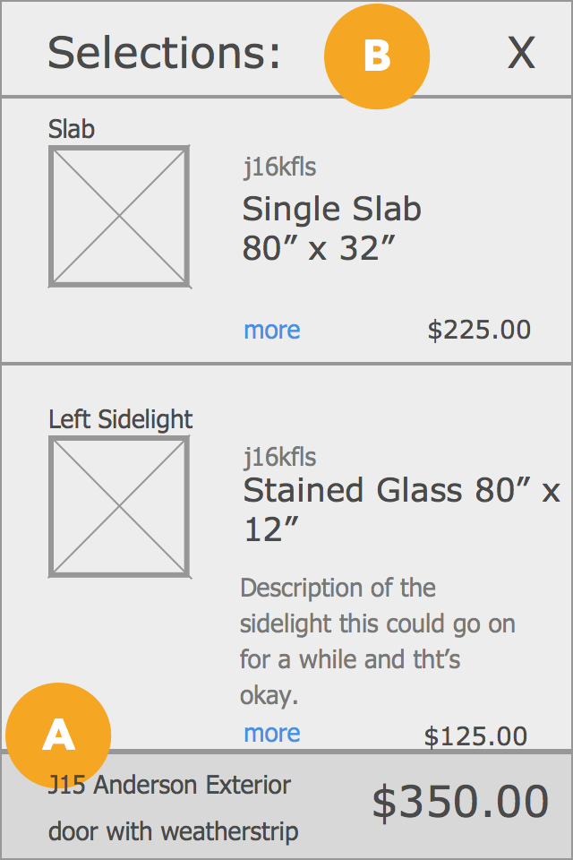

Slide 16
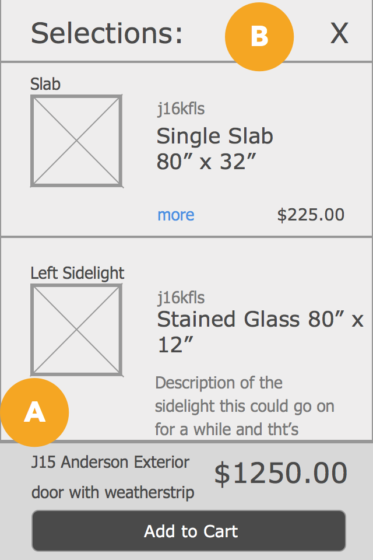

Slide 17
Tablet

Slide 18
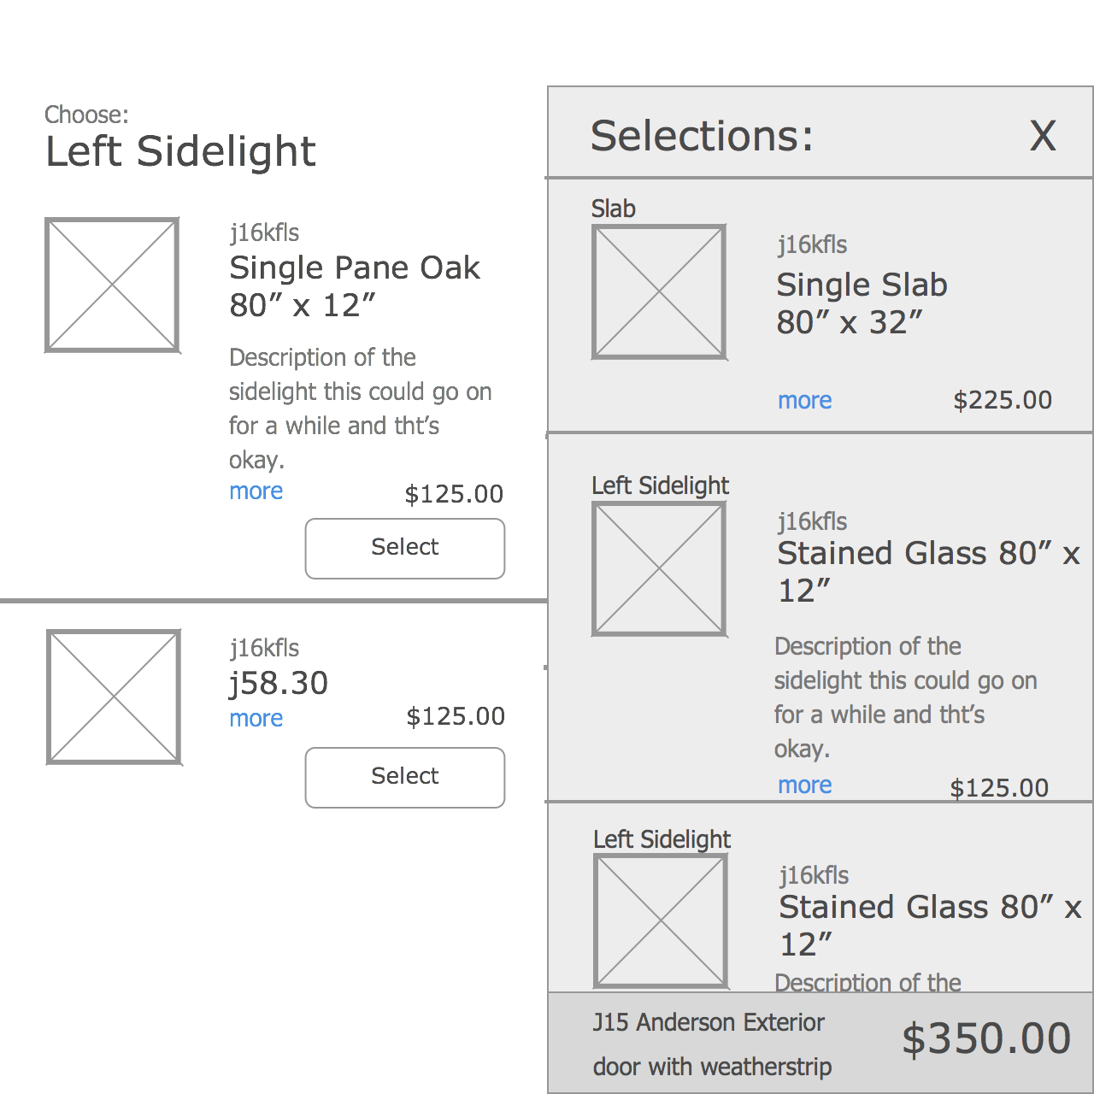

Slide 19
Desktop

Slide 20
